Slide 1

Technical Deep Dive: AI High-Precision Threat Prediction
A 60-second overview of the robust machine learning foundation driving our real-time network traffic analysis agent.

Slide 2





Presentation Agenda
Data Source & Preparation
Identifying and refining the foundational real-world dataset.
Model Selection & Training
Evaluating ensemble models and selecting the optimal prediction engine.
Critical Network Features
Defining the specific indicators used for malicious activity detection.
Precision & Deployment
Achieving high accuracy and detailing the final operational architecture.

Slide 3
1. Data Source and Preparation: Building a Robust Foundation
The performance of any autonomous threat prediction agent relies heavily on high-quality, real-world data to accurately map subtle network anomalies.
High-Quality Foundation
Real-World Traffic Log
We utilised the comprehensive CSE-CIC-IDS2018 dataset, globally recognised for its breadth and realism in capturing modern network attacks and benign traffic.
This dataset consists of extensive, real-world traffic log files, ensuring our model is trained on scenarios beyond synthetic or simplified environments.

Slide 4




2. Model Selection: Optimising for Performance
To achieve high-precision, real-time prediction, we systematically evaluated several state-of-the-art ensemble learning techniques.
Initial Evaluation
Reviewed Random Forest for its strong generalisation and robustness against overfitting.
Second Candidate
Tested LightGBM, focusing on its speed and efficiency in handling large datasets.
Final Selection: XGBoost
Ultimately selected XGBoost for its consistently superior performance metrics in classification accuracy and feature importance ranking.

Slide 5



3. Critical Network Features for Analysis
The XGBoost model was trained to analyse specific network features that serve as critical indicators, allowing it to move beyond simple pattern matching to genuine threat identification.
Connection Features
Packet Features
Flow Features
Metrics related to the speed and overall volume of connections. Anomalies here often indicate port scanning or denial-of-service attempts.
Analysis of patterns in the size, sequence, and timing of individual data packets, which can reveal signature-less exploit activity.
Unique characteristics derived from the overall data flow (e.g., flow duration, total bytes), crucial for differentiating benign traffic from a high-confidence attack flow.

Slide 6



4. Precision and Deployment
Achieving high prediction accuracy is non-negotiable for autonomous threat mitigation. Our technical implementation prioritises both precision and processing speed.
95%
98%
100%
Prediction Accuracy
Recall Rate
Real-Time Capability
The trained XGBoost model delivered over 95% accuracy in identifying potential threats, a precision level essential for trustworthy autonomous action.
High recall ensures that the model minimises false negatives, effectively catching most real attack attempts before they inflict damage.
The architecture is designed to process and classify network flow features instantaneously, meeting the demands of real-time security operations.

Slide 7
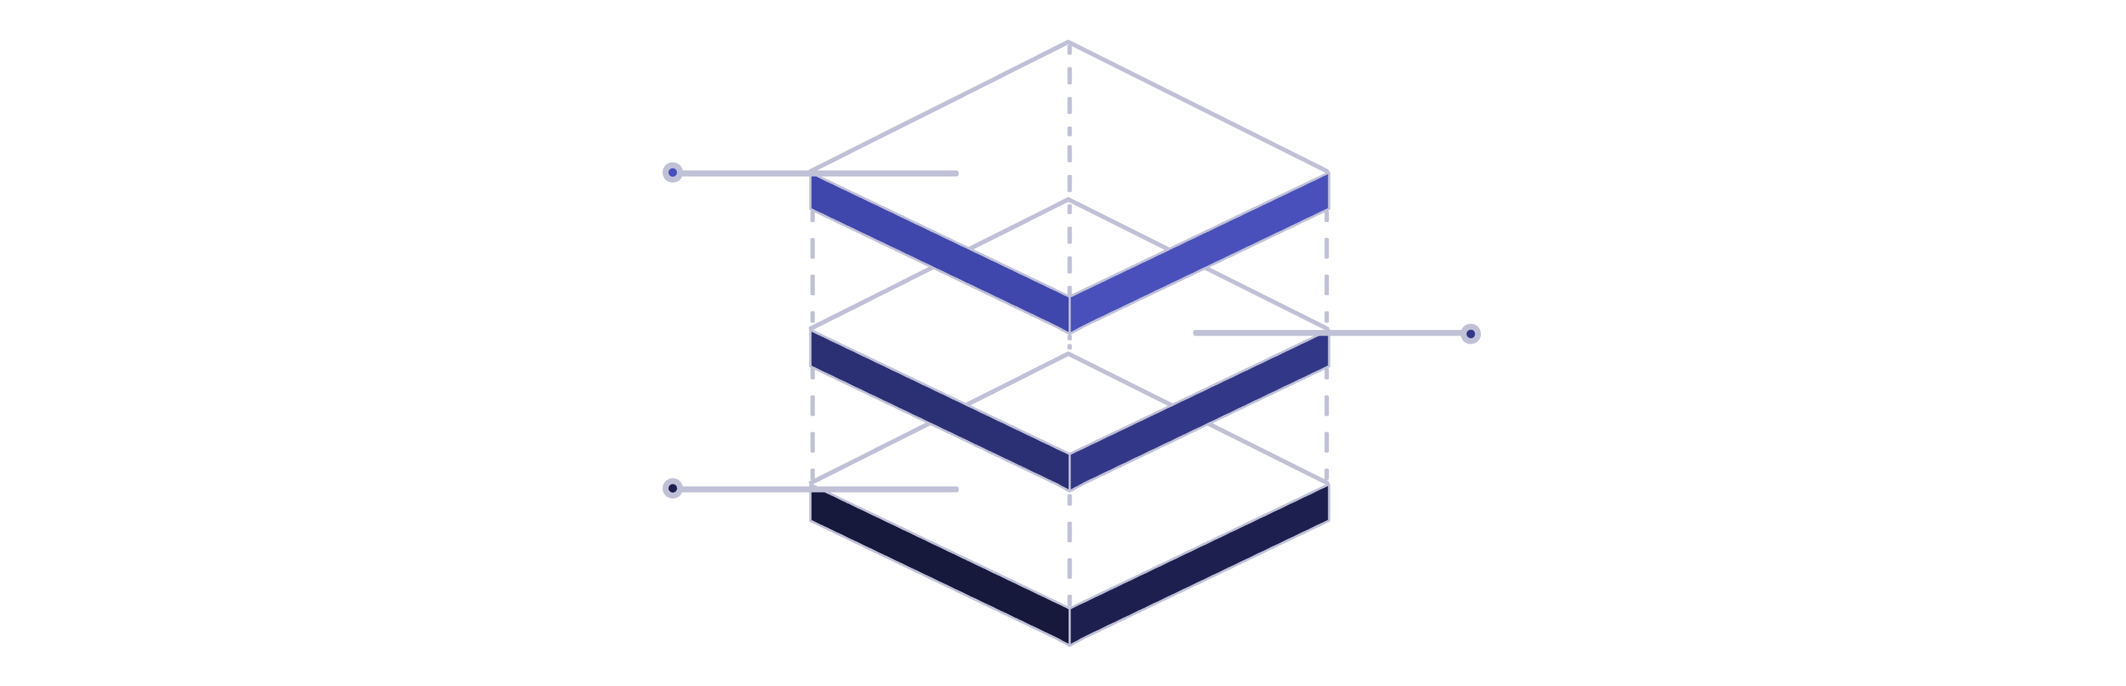
Optimised Deployment Architecture
The final architecture is a simple, performance-focused setup designed for maximal processing efficiency and scalability in diverse network environments.
App Backend & UI
Node.js API and React frontend
XGBoost Server
Dedicated model for classification
Network Input
Ingress of raw traffic data

Slide 8


Component Breakdown
XGBoost Model Server
Node.js Backend
Handles API requests, communication with mitigation systems, and aggregates prediction data from the model server before transmission.
A dedicated, high-performance server running the prediction engine, isolated for fast, low-latency processing and high-confidence classification.
React Frontend
Provides visual monitoring dashboards for security analysts, displaying real-time alerts, flow characteristics, and overall network status.

Slide 9

Key Takeaways: Robust ML for Security
Foundation: Training on the 6.4 GB CSE-CIC-IDS2018 dataset ensures robust, realistic learning against modern attack vectors.
Engine: XGBoost was chosen for its superior performance, enabling high-confidence threat classification based on detailed network feature analysis.
Precision: The model consistently achieves over 95% prediction accuracy, vital for enabling autonomous, low-risk mitigation actions.
Architecture: A dedicated three-server setup ensures model isolation and fast processing, guaranteeing real-time deployment capability.

